Slide 1

January 15, 2020

Slide 2



Acknowledgements & Sponsors

Slide 3
Important Points
Emergency exits
Feedback
https://github.com/PyDataAnnArbor
We’re in a borrowed space, please clean up after yourself

Slide 4
Q&A
Unless quick, hold questions until the end
Please phrase your question in a form of a question
Try to keep questions to 30 seconds or less
Avoid long statements or monologues
There will be time for open discussions after Q&A

Slide 5
PyData Code of Conduct
http://pydata.org/code-of-conduct.html

Slide 6
Quick Icebreaker

Slide 7
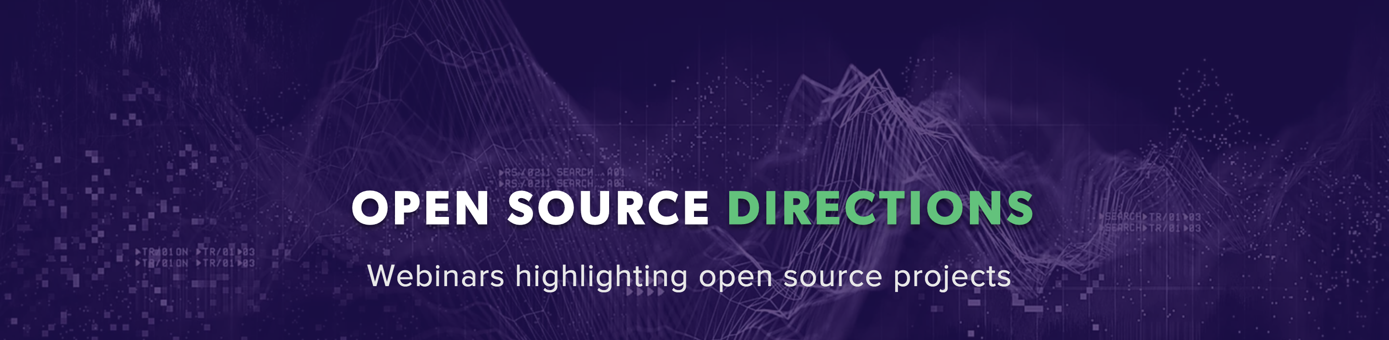
This Month in Data Science
Hosted by Quansight
https://www.quansight.com/open-source-directions
Notes:
Flair embeddings, ELMO embeddings, and BERT Embeddings

Slide 8

Next Event
Who: Amy Hemmeter (Interactions)
What: Summarization of News Articles Using TextRank
When: Wednesday, February 12th, 2020 (6:00pm)

Slide 9
Seeking panelists for discussion after Code: Debugging the Gender Gap
March 11, 6:30 p.m.
Prefer > 5 years of experience in the technology/software engineering field (contributor/management role). Emphasis on elevating voices of underrepresented minorities or diverse persons across any axes.
Email Brooke Wolford, bwolford@umich.edu for info

Slide 10
Community Announcements?

Slide 11
January 15, 2020

Slide 13
Researcher Developer Engineer Data Scientist
jobs.tdameritrade.com

